Slide 1

100% original.
40% less CO₂.*
Makes sense.
Resources and factsheet

Slide 2
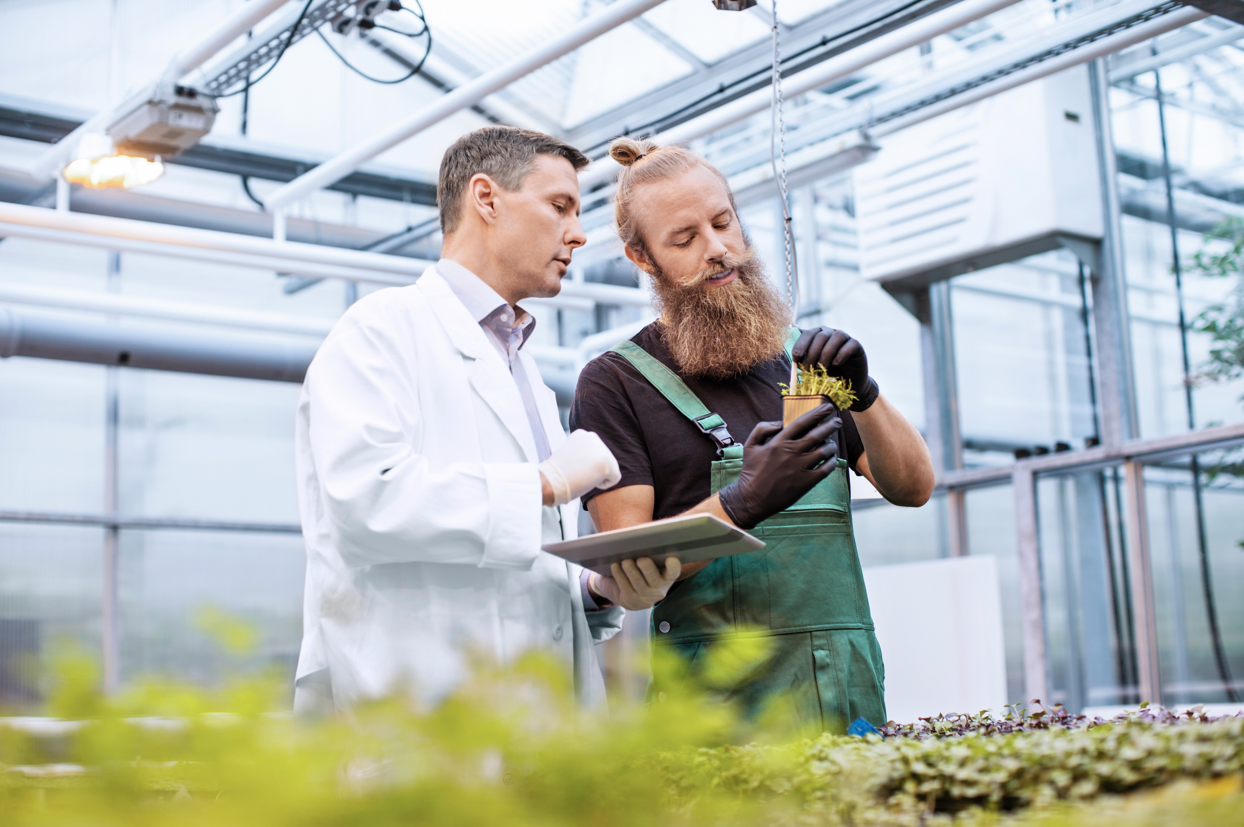
tesa® 4965 Original Next Gen
Same value, just less CO₂.
-40%* CO₂ based on figures from ISO 14067 verified study
Biomass balanced adhesive components and 90% PCR PET in the backing
Performs equally as reliably as older version in testing
*Product Carbon Footprint (PCF) reduction for the new tesa® 4965 Original Next Gen (50m x 50mm handroll, PV0: red MOPP liner) compared to the current tesa® 4965 Original (50m x 50mm handroll, PV0: red MOPP liner) calculated in 2023 with Cradle-to-Gate values including biogenic carbon uptake. Individual PCF values for the other liner types (PV1, PV2, PV4) and further information you can find in our ISO 14067-compliant comparative PCF calculation on tesa.com/4965-report.

Slide 3
tesa® 4965 Original Next Gen
From source to tape
Includes biomass balanced adhesive components
Non-fossil feedstocks are used in equivalent quantities of production
Components are tracked, verified and certified by ISCC PLUS
Ensures the whole supply chain contains sufficient biomass balanced adhesive components
Enables customers to design more sustainable products in their own value chain, supporting sustainability goals

Slide 4
tesa® 4965 Original Next Gen vs tesa® 4965 Original
Same tape. Same reliable performance.
Same product specification
Same performance as tesa® 4965 Original
Comparative tensile strength in the 90% PCR PET-backed tape to the original PET backing
Equal percentage of elongation
Same peel adhesion

Slide 5
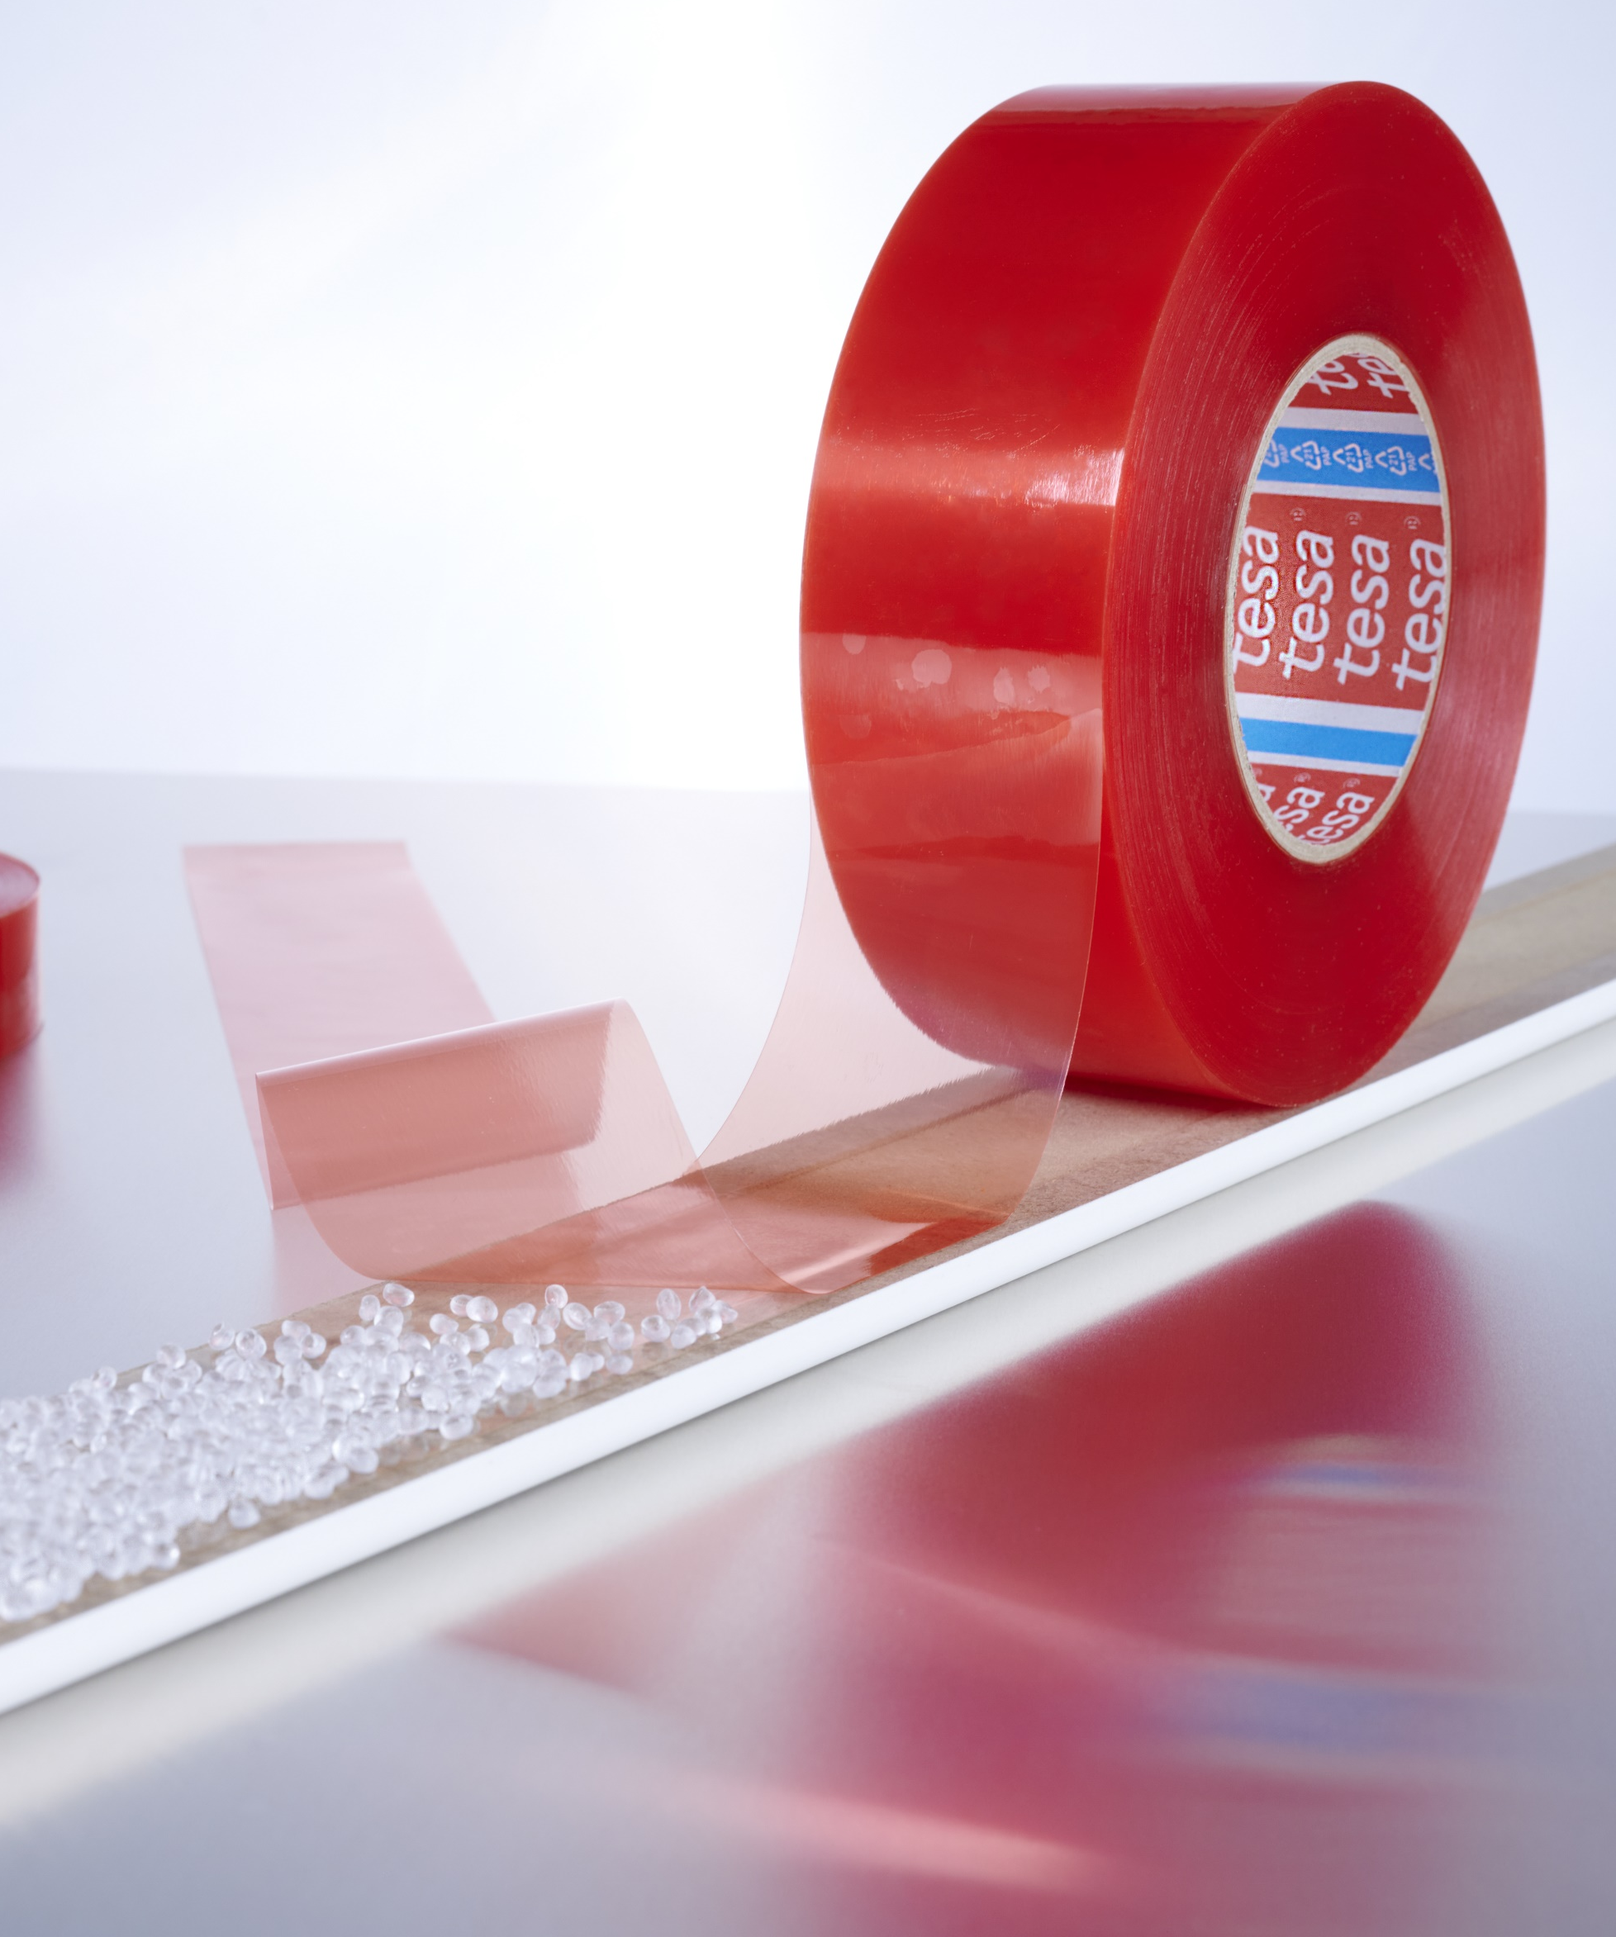
tesa® 4965 Original Next Gen
100% original. 40%* less CO₂. Makes sense.
tesa® 4965 Original – a trusted tape for four decades
A reliable solution across many industries and applications
Now available as the next generation – tesa® 4965 Next Gen – with a 40%* reduction in CO₂ emissions
*Product Carbon Footprint (PCF) reduction for the new tesa® 4965 Original Next Gen (50m x 50mm handroll, PV0: red MOPP liner) compared to the current tesa® 4965 Original (50m x 50mm handroll, PV0: red MOPP liner) calculated in 2023 with Cradle-to-Gate values including biogenic carbon uptake. Individual PCF values for the other liner types (PV1, PV2, PV4) and further information you can find in our ISO 14067-compliant comparative PCF calculation on tesa.com/4965-report.

Slide 6





tesa® 4965 Original Next Gen
Same versatility in application.
Electronic devices
Securing small (and tricky) components.
Aviation
Securing LED lighting to the flooring within commercial airliners.
Logistics
Closing packaging.
Point of Sale
Securing pricing displays in a retail
environment.
Building & furniture components
Maximum bonding safety for
furniture elements and interior fit-out.

Slide 7
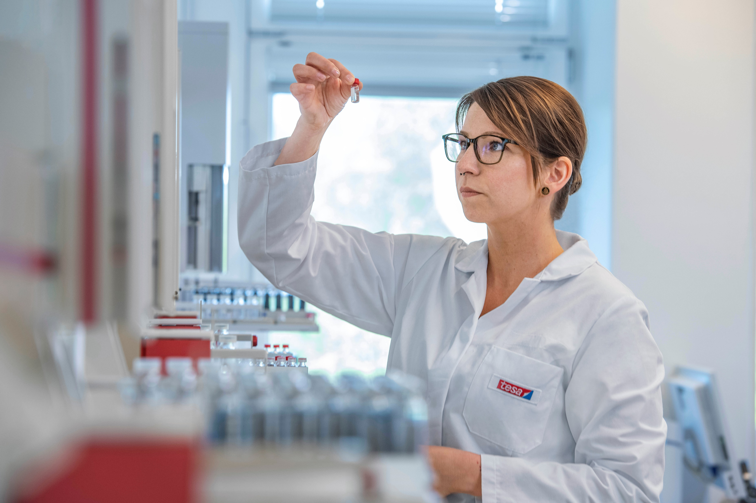
tesa® 4965 Original Next Gen
Same reliable performance. 40%* less CO₂. Makes sense.
Similar properties and adhesion values give the new tesa® 4965 Original Next Gen tape the same advantage in performance over other adhesive solutions as
tesa® 4965 Original.
Combined with our decades of industry know-how and focus on sustainability, we are on the path to a more sustainable product line. It just makes sense.
Visit the tesa® 4965 Original Next Gen page to find out more.
*Product Carbon Footprint (PCF) reduction for the new tesa® 4965 Original Next Gen (50m x 50mm handroll, PV0: red MOPP liner) compared to the current tesa® 4965 Original (50m x 50mm handroll, PV0: red MOPP liner) calculated in 2023 with Cradle-to-Gate values including biogenic carbon uptake. Individual PCF values for the other liner types (PV1, PV2, PV4) and further information you can find in our ISO 14067-compliant comparative PCF calculation on tesa.com/4965-report.

